Slide 1











Genève
Advisory Board
Valais
research & development
research & development
UNIGE
deployments

Slide 2

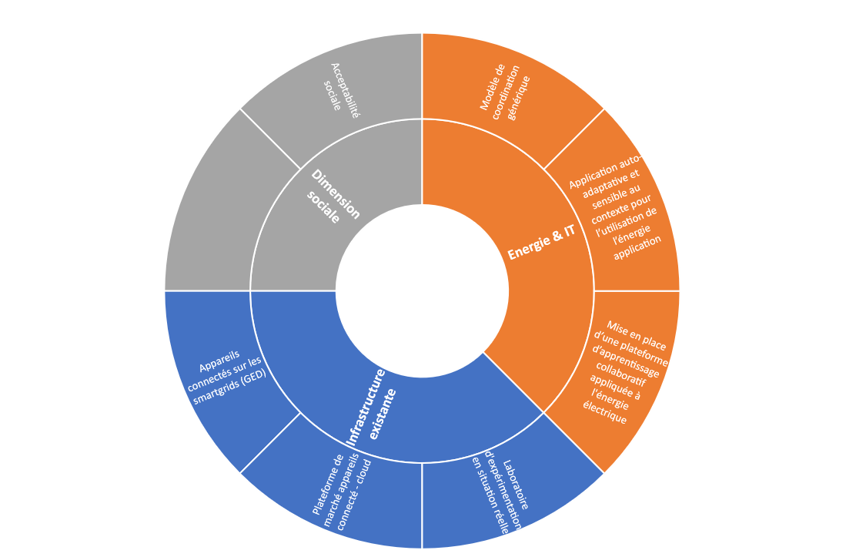

Slide 3
